Slide 1
WELCOME

Slide 2
FPS INVENTORY

Slide 3
Be simple

Slide 4

Store A
SUPPLIERS
CENTRAL WAREHOUSE
Store B
Store C
Centralized Stock Control

Slide 5
GOAL

Slide 6

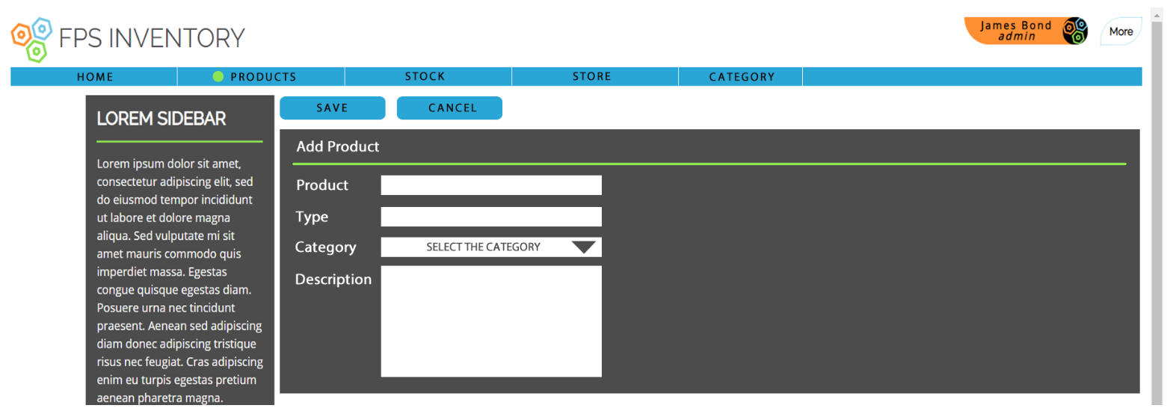
Products

Slide 7
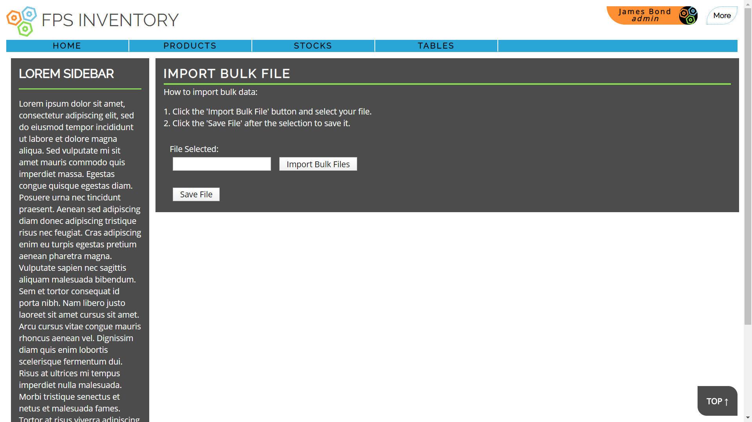
Products

Slide 8
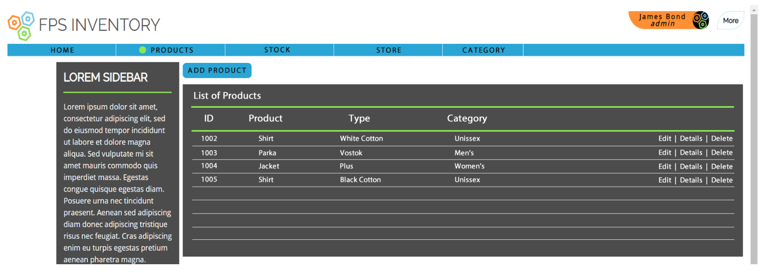
Products

Slide 9
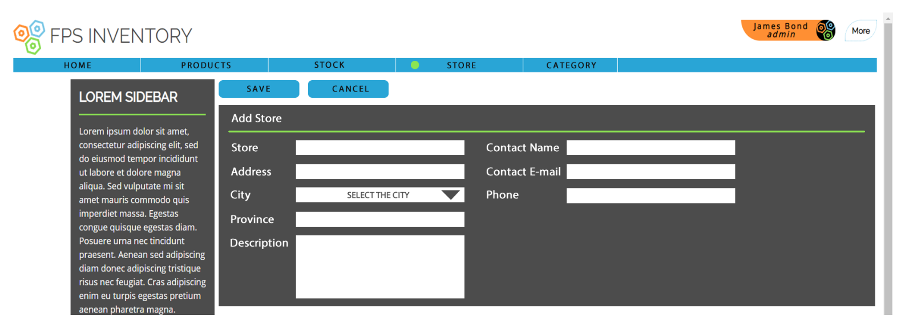
Stores

Slide 10
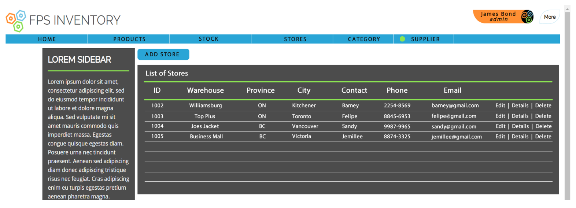
Stores

Slide 11
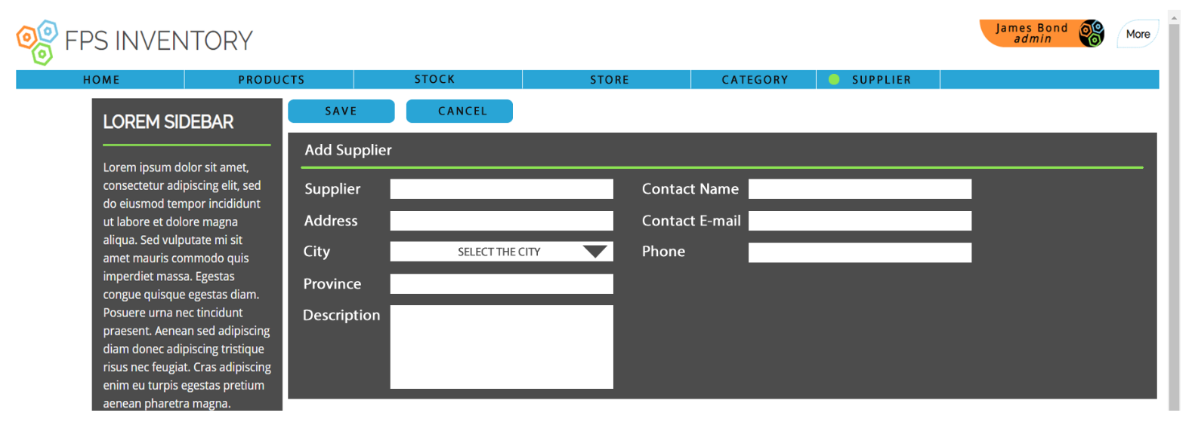
Suppliers

Slide 12
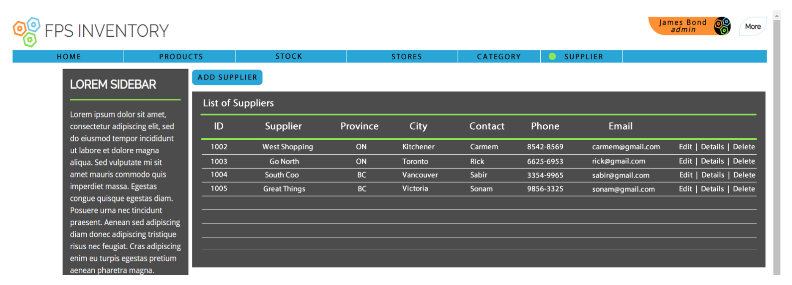
Suppliers

Slide 13
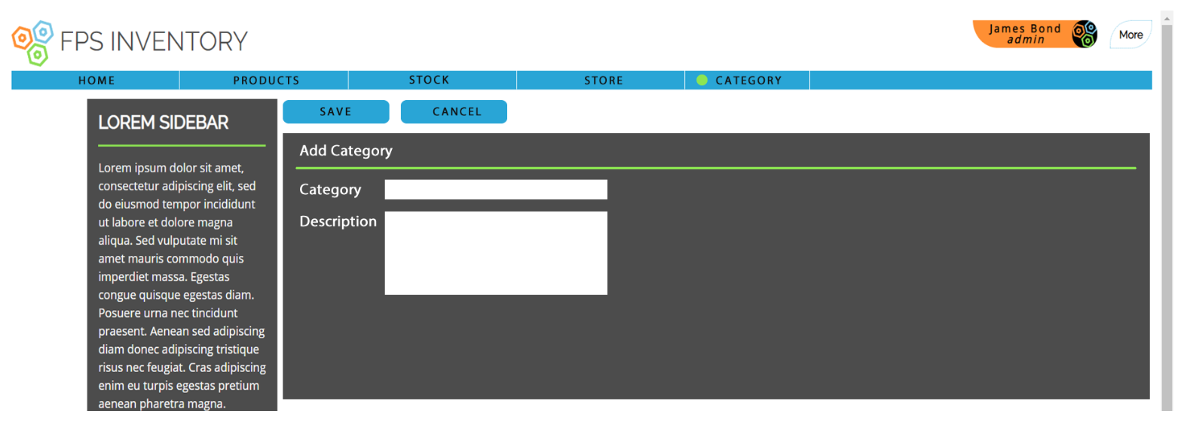
Category

Slide 14
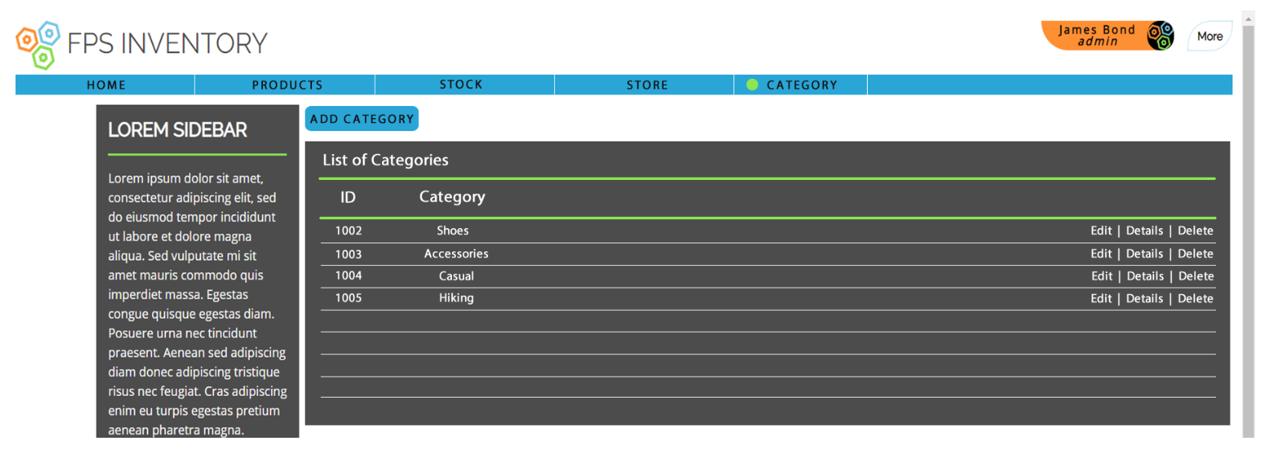
Category

Slide 15
Business

Slide 16
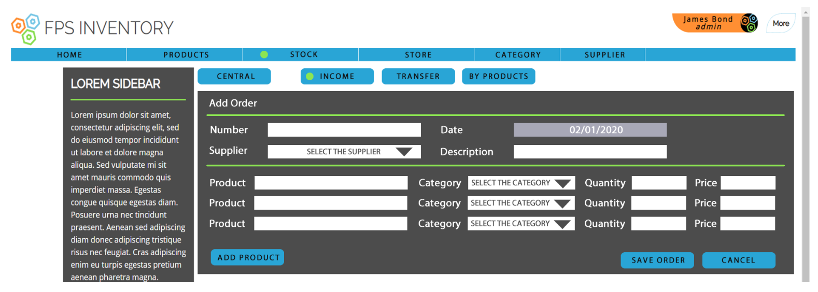
Income

Slide 17
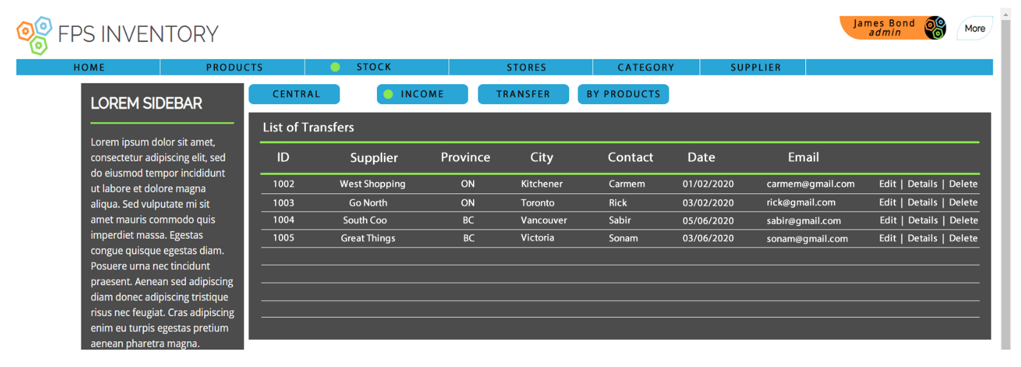
Income

Slide 18
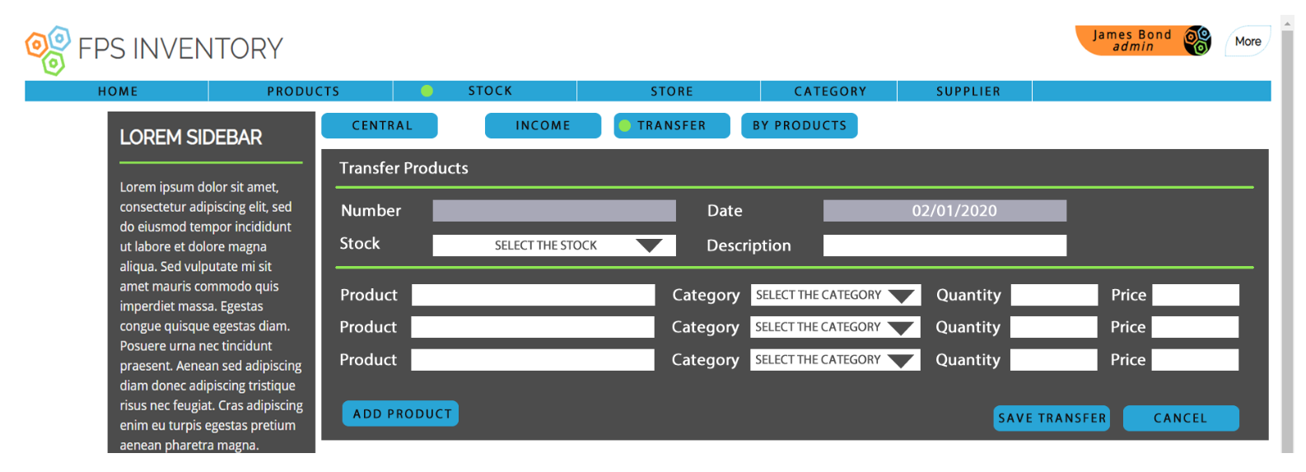
Store Transfers

Slide 19
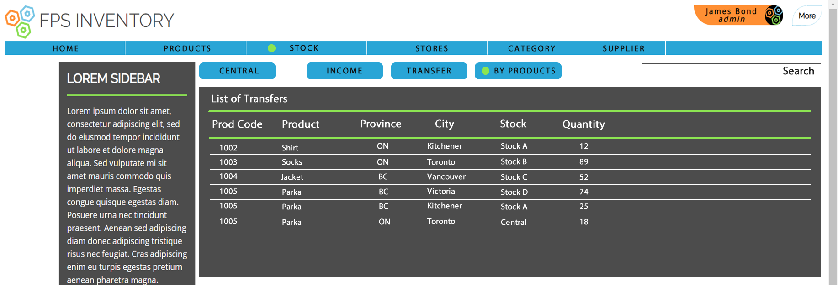
Stock Control

Slide 20
Access Control
Easy Operation
Simple Design
Any Business

Slide 21
Contact us
Sandy
Felipe
Jemillee
www.fpsinventory.com

Slide 22
Visit today
www.fpsinventory.com

